Slide 1
Java Online documentation
King Saud University – Collage of computer and information Sciences
CSC 113

Slide 2

Packages, classes, and methods
Java provides a mechanism for organizing classes into logical/related components.
A package consists of a group of classes that are logically related.
A class consists of a group of methods having related functionality.
You can create your own java package
Java packages usually have a .jar extension.
Classes declared in the same folder are by default considered in one package.
Notes:
Remind about the Protected visibility

Slide 3
Java language- a wider look
Java provides a very big collection of ready-to-use packages and classes to perform variety of programming tasks such as:
String manipulation.
Math computation.
File processing.
Database access.
Networking.
Graphical user interface.
2D and 3D graphics.
Game development.
Etc…

Slide 4
Java online documentation
In this lesson we introduce the detailed online java documentation, Were you should be able to:
Search for any classes that may fit your specific programming needs.
Find and understand all the available parameters and methods of a specific class.
Find the exact syntax of a method to be used.

Slide 5

Java online documentation
http://www.oracle.com/technetwork/index.html

Slide 6
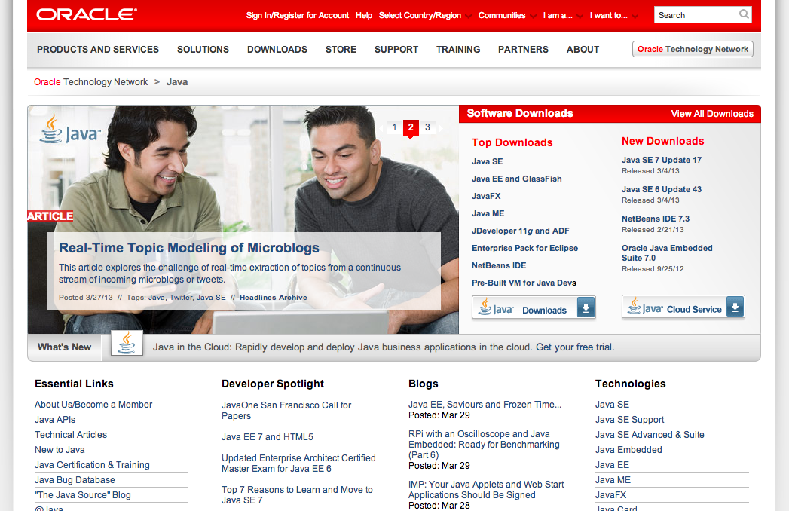
Java online documentation

Slide 7
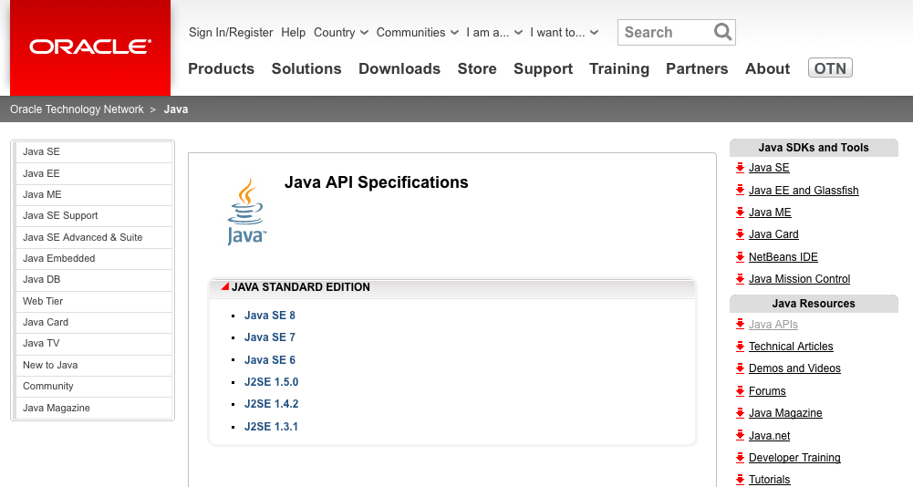
Java online documentation

Slide 8
Useful Resources
An Introduction to Object-Oriented Programming with Java, C. Thomas Wu.
Java(TM) Programming: From Problem Analysis to Program Design, D.S. Malik.
http://www.tutorialspoint.com/java/

